Slide 1
Parent Forum
Sporting Fixtures

Slide 2
From the parent survey
Going well
Questions
Amazing opportunities for inter-school sports
Lovely to see so many sporting events
Selection process for events

Slide 3
At our school, we provide two types of sporting opportunities for children:
  Competitions
  Festivals

Slide 4
Competitions
More competitive events where schools compete against each other
These events provide an opportunity for children who excel in sport
80%:20%
  Children who have developed skills in the sport
  Newer to the sport but still demonstrate enthusiasm and competitiveness
Competitive
  increases our chances of securing more places in future competitions
As part of our selection process, priority is given to children who attend relevant school sports clubs.
  Basketball club children will have first consideration
  Hockey
However, we do keep track of all participants to ensure a fair distribution of opportunities across different competitions.

Slide 5
Festivals
Non-competitive events
  Designed for children who may not have as much experience in a sport or prefer a more relaxed environment.
These events focus on fun, teamwork and skill development.
Children who are not selected for tournaments are prioritised for festivals.
We acknowledge that there are often more tournaments than festivals in any given term
  Determined by external organisers.

Slide 6
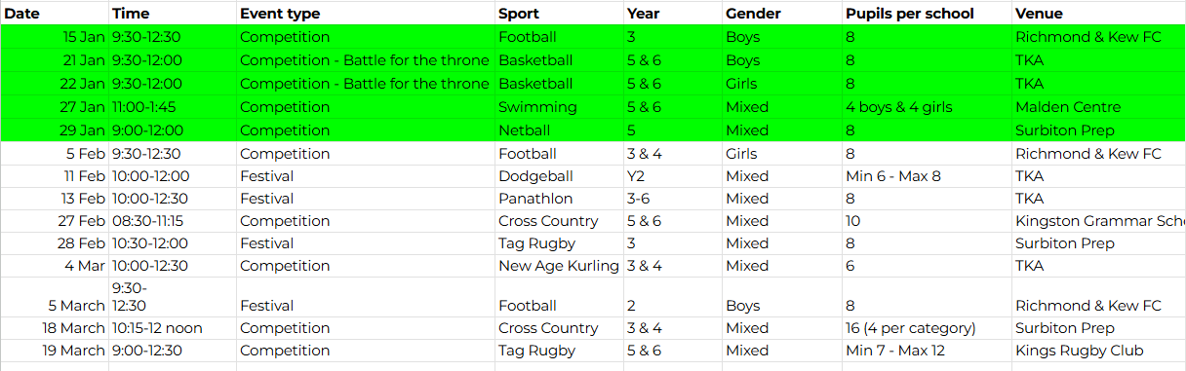

Slide 7
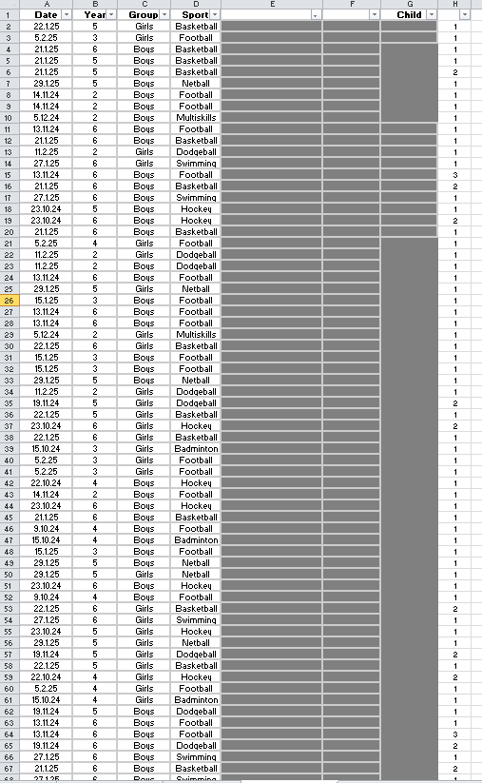
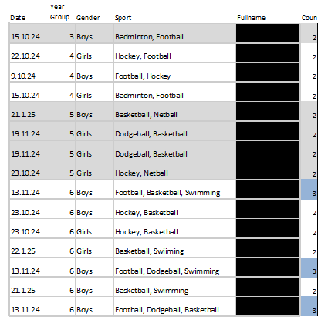
Ensuring Fairness and Opportunity

Slide 8
Challenges and Considerations
Many more children in school then places for the events.
Sports day all get to compete.
Other opportunities for our children to compete with other schools outside of the competitions and festivals
While we strive to send staff who are familiar with each sport, there are times when this is not possible.
  More beneficial for children to have the opportunity to take part than to miss out.
Sporting events with very little notice.
  This is a common challenge faced by all schools in our borough.
Mr Tagg and Mr Williams
  Hockey, football, cricket clubs run by teachers in their own time.
  Listened to parents about offering pre-competition coaching (e.g. netball and basketball this term).

Slide 9
Parental Support & Volunteering
Expand our network of parents who may be able to support or coach at sporting events.
Expertise in a particular sport or would be interested in helping to supervise or coach children at competitions or festivals

